Slide 1
Network for federated learning task
Building a Real-Time Bidirectional Communication System with Raspberry Pi and Python

Slide 2
System Overview
System Components
3 Raspberry PI devices (senders and receivers)
1 Laptop (central controller / data processor)
Local network (Wi-Fi or Ethernet)
MQTT Broker (can be on one of the Raspberry Pis or the laptop)
In this project, we could a communication system where three Raspberry Pi devices and a laptop can exchange data in real-time. The system uses Python and MQTT to enable lightweight, two-way communication over a local network.
Each Raspberry Pi acts as both a data sender and receiver. The laptop collects data from the Pis and can respond to them. All devices are connected through a local network, and they communicate via a central MQTT broker.

Slide 3
Communication Model
Message Flow
Raspberry PIs publish analysis results to the broker
Laptop subscribes and processes results
Laptop sends feedback to each Raspberry Pi via dedicated topic
Raspberry Pis publish analysis data to the broker. The laptop subscribes to these topics, processes the data, and then publishes feedback messages. The Pis subscribe to their own feedback channels and respond accordingly

Slide 4
Why MQTT?
Lightweight and ideal for IoT
Supports pub/sub pattern
Enables bidirectional communication
Works great with Python (paho-mqtt library)
Real-time capabilities
MQTT is perfect for this kind of system. It’s a lightweight publish-subscribe protocol designed for constrained devices and low-bandwidth networks. It’s also very easy to use in Python, which made development fast and flexible

Slide 5
Technology Stack
Python for all scripts
paho-mqtt for MQTT communication
Mosquitto as MQTT broker
JSON for structured messages
The system is built entirely in Python, using the 'paho-mqtt' library to handle messaging. For the MQTT broker, I used Mosquitto, which is open-source and simple to set up. Messages are sent as JSON, making it easy to structure and parse data.

Slide 6
MQTT topics
Device | Publish Topic | Subscribe Topic
Raspberry Pi 1 | raspi/1/data | raspi/1/feedback
Raspberry Pi 2 | raspi/2/data | raspi/2/feedback
Raspberry Pi 3 | raspi/3/data | raspi/3/feedback
Laptop | all /data topics | all /feedback topics
This table shows the MQTT topic structure. Each Pi publishes to its own
/data topic and listens for feedback on a matching /feedback topic.
The laptop listens to all /data topics and sends feedback back to each specific Pi.

Slide 7
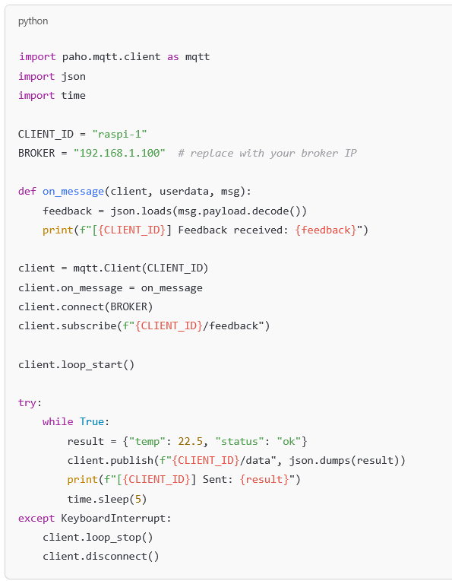
PI code example
The laptop subscribes to all Pis’ data topics.
When it receives a message, it processes it and sends a
response to the matching Pi’s feedback topic.
The message routing is handled based on topic names,
making it easy to scale to more devices.

Slide 8
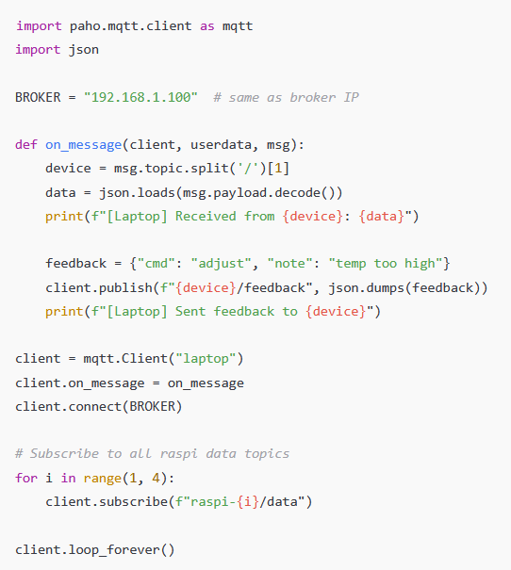
Laptop example
Mosquitto is the MQTT broker.
Once installed and running,
it handles all message delivery automatically between
publishers and subscribers

Slide 9
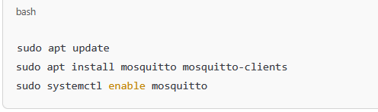
Broker setup
Mosquitto is the MQTT broker.
It can be installed on any of the devices,
though I chose the laptop for simplicity.
Once installed and running, it handles all
message delivery automatically between
publishers and subscribers

